Slide 1
Welcome To Vietnam

Slide 2
AGENDA
01.
Vietnam: maintain its commitment to free trade.
02.
Opportunities of selling on Amazon

Slide 3
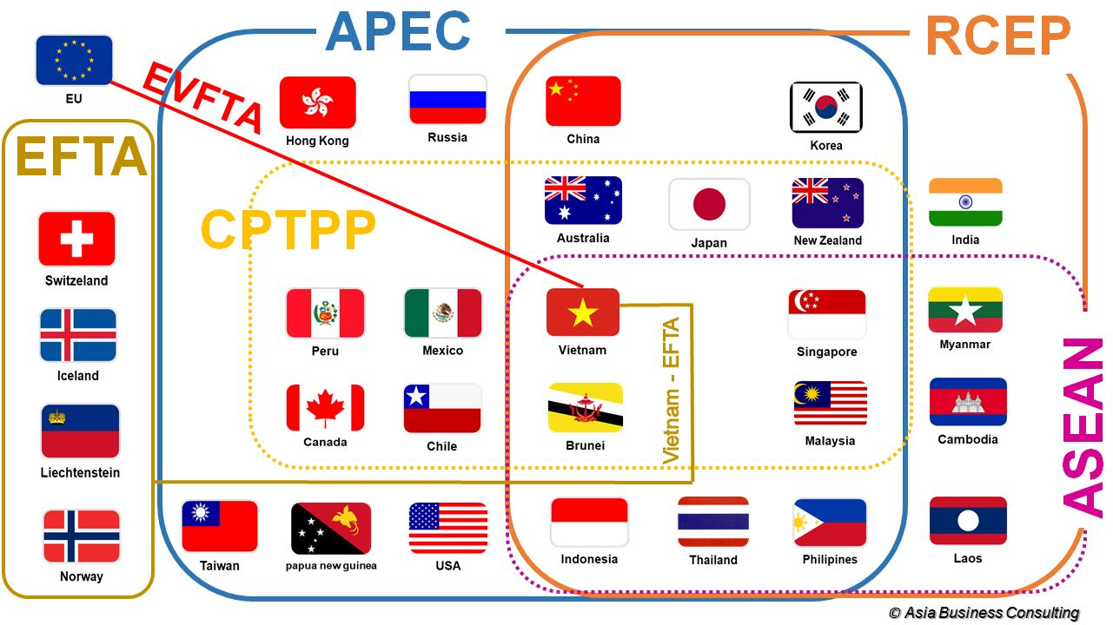
Vietnam: Maintain its commitment to free trade.
Up to date, Viet Nam has signed
16 FTAs
& 3 FTAs under negotiation
CPTPP signed in 2018 by signatories across the Asia–Pacific region.
The EVFTA signed in 2019 ( Vietnam & EU).
The RCEP was signed by 10 ASEAN member states and five non-ASEAN members (Australia, China, Japan, Republic of Korea and New Zealand).
The UK-Viet Nam Free Trade Agreement was signed in 2020.
Vietnam is currently negotiating the Indo-Pacific Economic Framework for Prosperity (IPEF) with the US and 13 other Asian countries.

Slide 4
Vietnam: Maintain its commitment to free trade.
Viet Nam has signed
16 FTAs (Free Trade Agreements)
& 3 FTAs under negotiation
CPTPP (2018): Asia–Pacific region
EVFTA (2019): Vietnam & EU
RCEP: 10 ASEAN member states & 5 non-ASEAN members (Australia, China, Japan, Republic of Korea and New Zealand)
UK-Viet Nam Free Trade Agreement (2020)
Negotiating Indo-Pacific Economic Framework for Prosperity (IPEF) with the US and 13 other Asian countries.

Slide 5
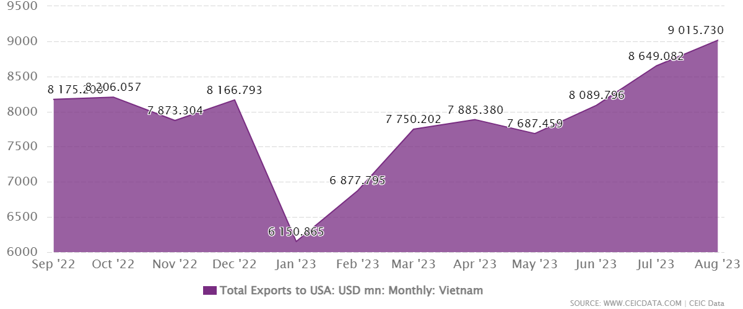
Import Duties for Furniture from Vietnam
Vietnam and the US do not have a free trade agreement, but have a bilateral trade agreement that reduces tariffs on certain goods, including furniture.
As a result, importers of Vietnamese furniture products can enjoy lower tariffs, or even no tariffs at all.

Slide 6
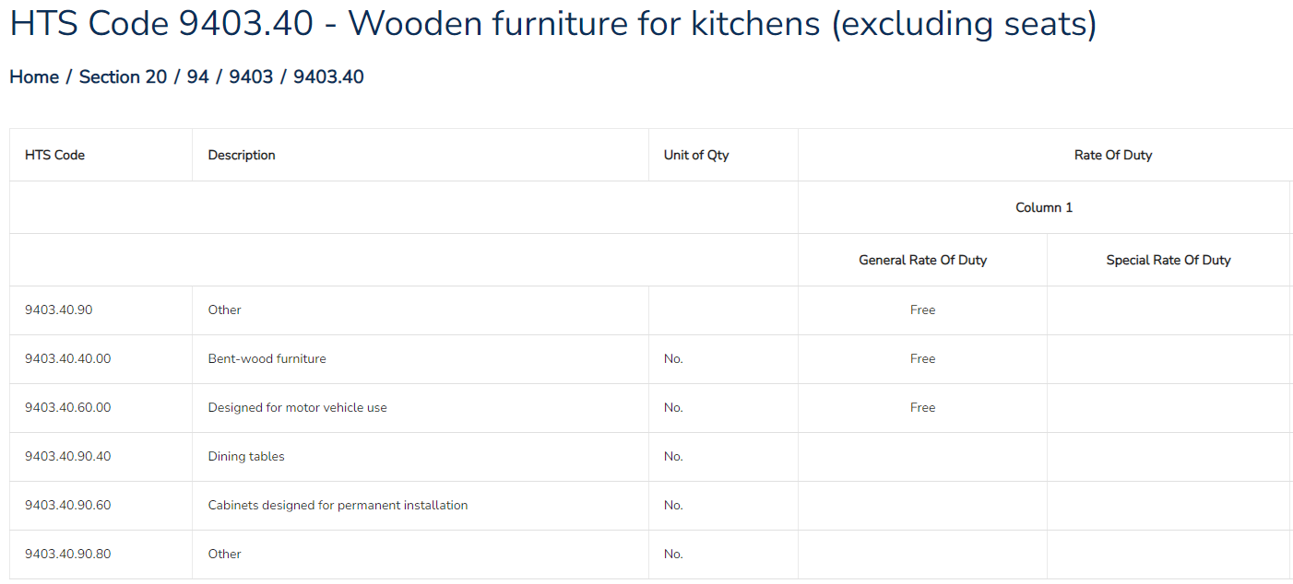
Import Duties for Furniture from Vietnam
For example, the HS code for wooden dining tables is 9403.40.90.
The general tax is noted as “Free” in the Harmonized Tariff Schedule, which means that wooden dining tables from Vietnam to the US are exempted from import tariffs.

Slide 7
Import Duties for Furniture from Vietnam
For example, the HS code for wooden dining tables is 9403.40.90.
The general tax is noted as “Free” in the Harmonized Tariff Schedule, which means that wooden dining tables from Vietnam to the US are exempted from import tariffs.

Slide 8
Vietnam & US Relations
The Vietnam-U.S. relationship has flourished vigorously and fruitfully, growing both in depth and substance

Slide 9
Sourcing- Vietnam factories
are not familiar with supplying Ecommerce
Nearly 7,000 businesses (including 3,000 export-focused businesses) participate in the wood furniture manufacturing market, with 3,900 manufacturers (56%) attending to produce indoor and outdoor furniture.
 | Group 1 | Group 2 | Group 3
Business scale | Large company | Medium company | Small company
Production capacity | 100-300 container 40ft | 20-100 container 40ft | Less than 20 container 40ft

Slide 10
Sourcing- Vietnam factories
are not familiar with supplying Ecommerce
The need to work with export-focused manufacturers
Alibaba isn’t the best resource
Scalable manufacturers are harder to find
It’s difficult for Ecommerce buyers to reach out to the factory’s decision makers
Slow response times
Limited Order Flexibility, Private label is much more difficult
Long lead time
Different culture
Supply chains still rely on China.

Slide 11
AGENDA
01.
Vietnam: maintain its commitment to free trade.
02.
Opportunities of selling on Amazon

Slide 12
CBEC helps businesses to approach global end consumers directly
Notes:
Re-used CBEC EXPO in June slides

Slide 13
Amazon’s Global Selling
Amazon’s Global Network
Supports Sellers To Sell Globally
22
400+
Physical Presence
Fulfillment Centers
500 Million
27
Languages
Square feet
200
100+
countries
Air cargo planes
300 Million+
200.000+
200 Million+
Customers
Amazon Robotic Units
Prime Members
¹ At the close of Q4 2017. Active customer accounts represent accounts that have placed an order during the preceding 12-month period
Notes:
With all these innovation over the past 20 years, we are building a strong business presence.
So far, we have established a physical presence in 18 countries, representing 75% of the world GDP.
We support 27 languages, reaching 300MM customers in 185 countries. With Amazon, you can quickly grow your business in other countries, introducing your brand and products to millions of customers in Amazon's marketplaces.
We have built amazing logistics infrastructures worldwide. Without the need for establishing your distribution network or setting up your overseas branches, your products can reach shoppers all over the world.
We have 175 FCs, 40 air cargo planes 100,000 Amazon Robotic Units that add further efficiency in operation.

Slide 14
Made-in-Vietnam Go Global on Amazon
Vietnamese selling partners sold 17+ million products in our online stores.
Export value of Vietnamese businesses selling with Amazon have increased
The number of Vietnamese sellers on Amazon has increased 40%
17
Million products
50%
40%
Source: Amazon data, 12months ending on 8/31/2023 compared to the same period the year before

Slide 15
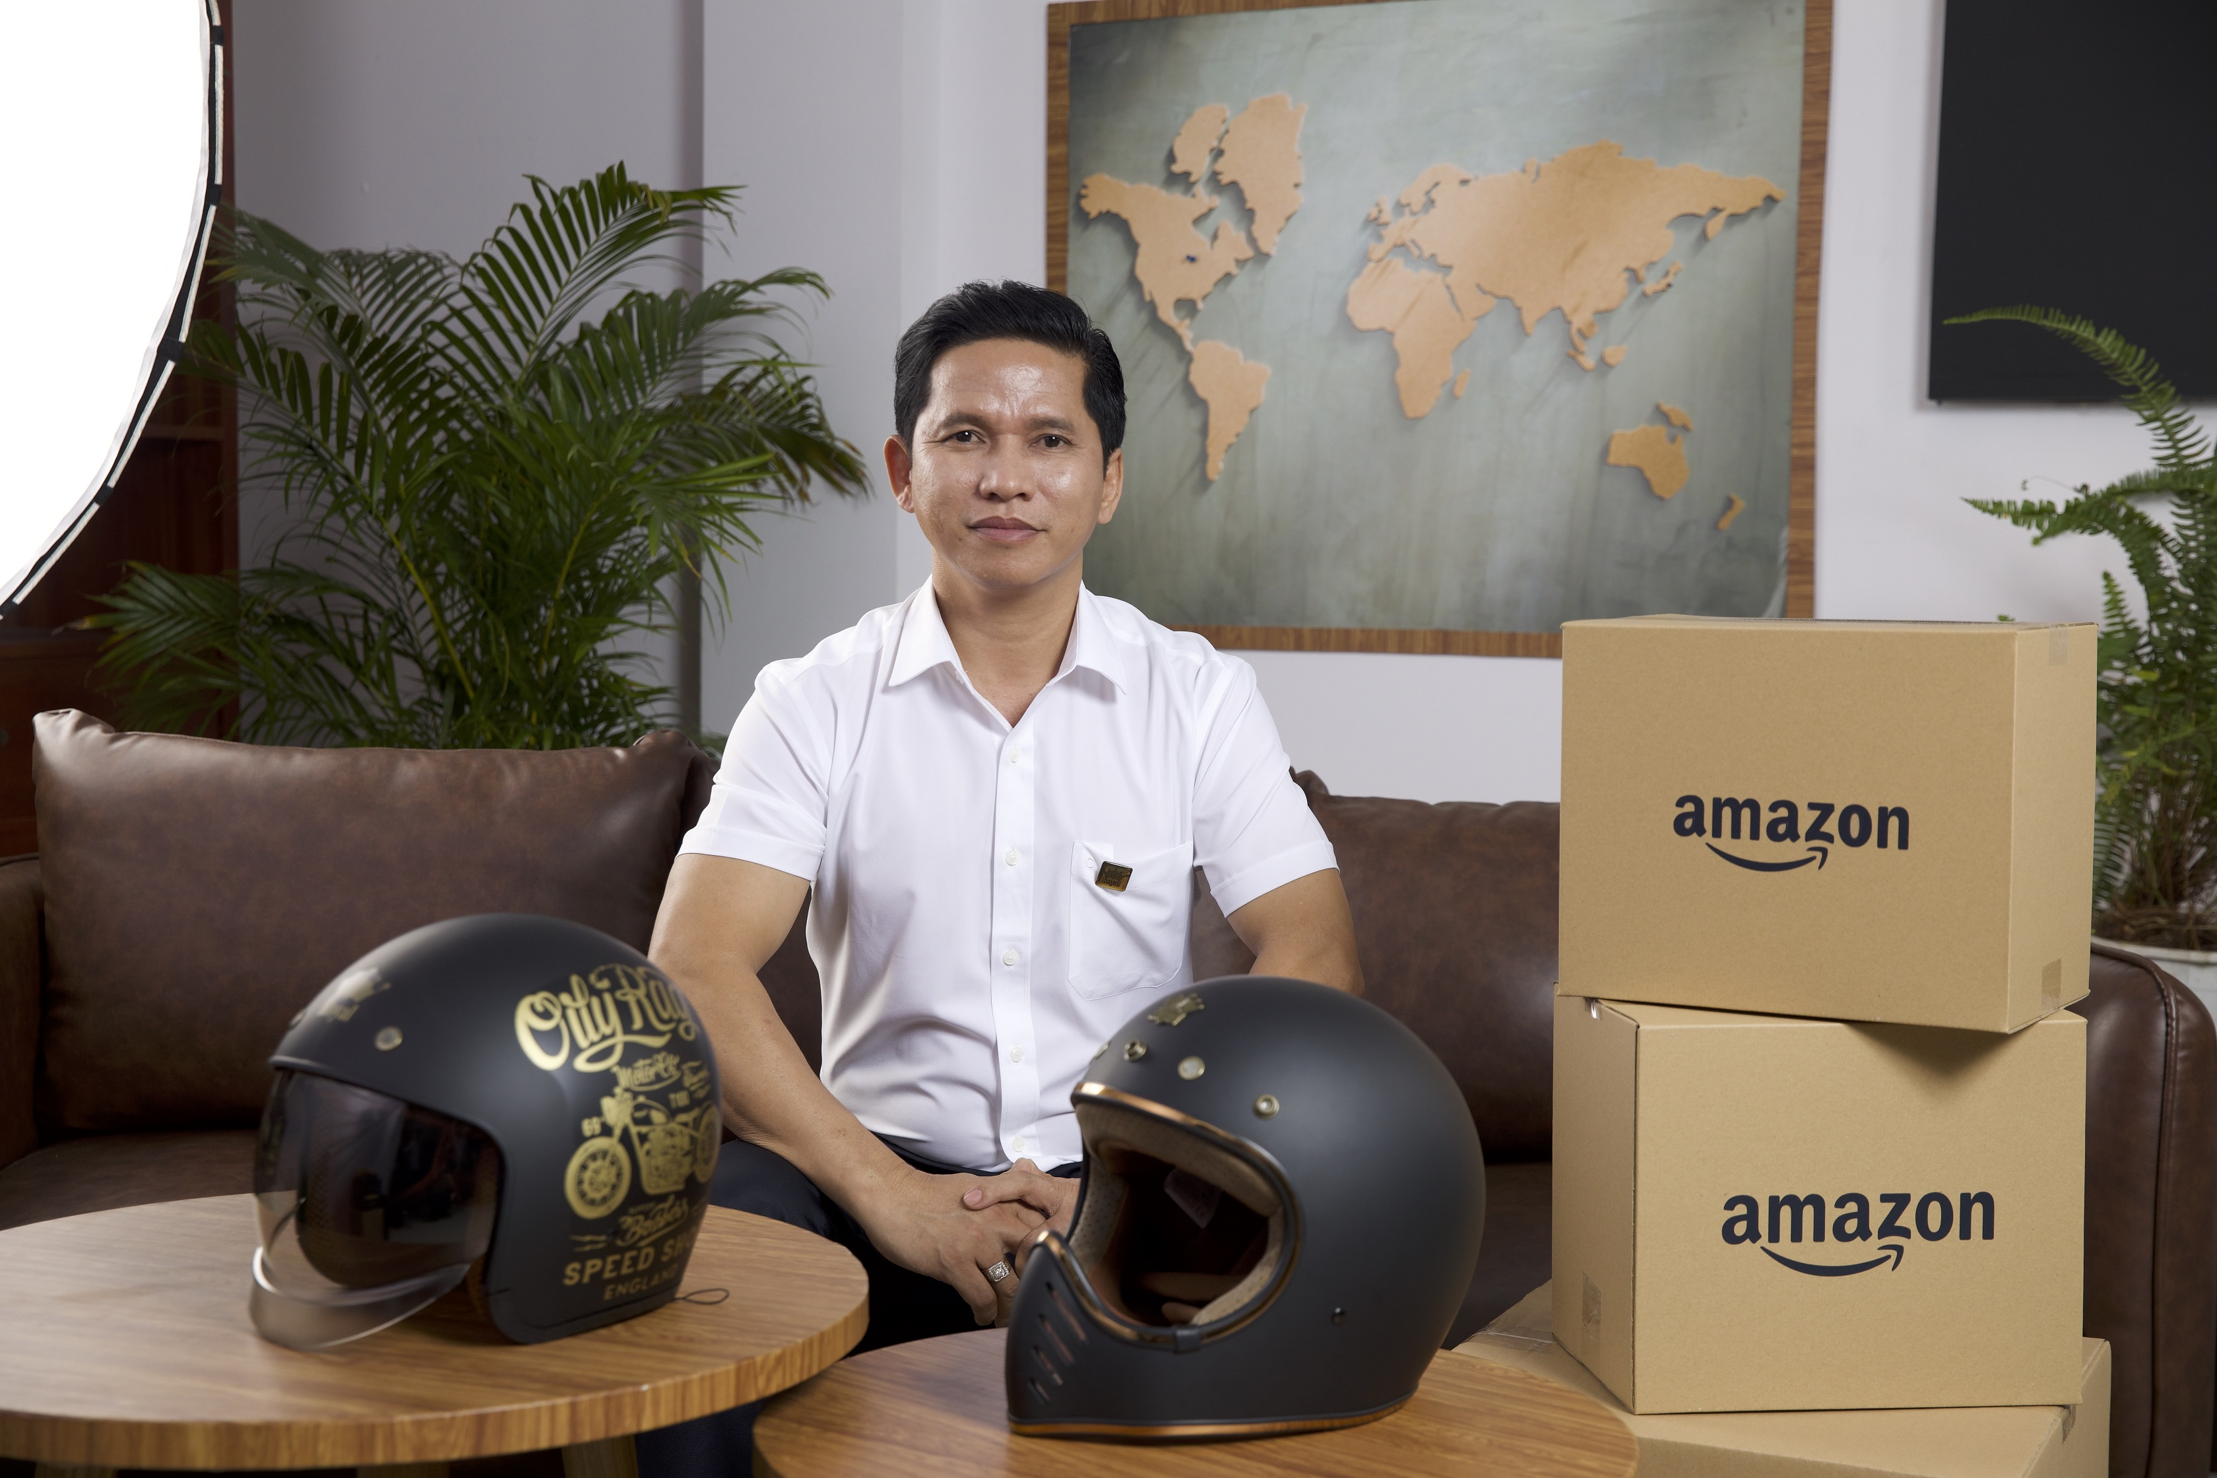
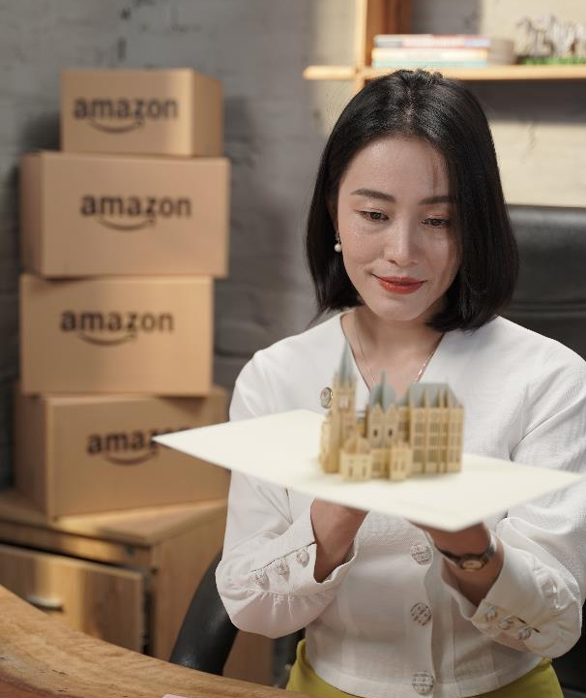
They have set sail with Amazon Global Selling
Minh Long
hành trình toàn cầu hóa của gốm sứ Việt Nam
Sunhouse
Mang gia dụng Việt Nam vào bếp nhà Âu, Mỹ
AnEco
“Nhựa xanh” Made-in-Vietnam ra thế giới.
Royal Helmet cánh chim đầu đàn ngành sản xuất nón bảo hiểm tiên phong “xuyên biên giới”
BeeFurni Từ gia công đến
làm chủ thương hiệu đồ gỗ nội ngoại thất quốc tế trên Amazon
Rong Nho Trường Thọ
mở lối đi riêng cho thủy sản Việt Nam ra quốc tế
LAFOCO
Nông sản Việt chất lượng không ngại thị trường khó
Thiệp 3D Made-in-Vietnam ra thế giới
cùng Amazon
EQUO Khởi nghiệp xanh với Ống hút từ cỏ, gạo, mía, cà phê gia nhập thị trường quốc tế
Mỹ nghệ cói xiên từ làng quê Việt ra thế giới

Slide 16
DAY ONE

