Slide 1


China Vietnam Cooperation Will Gain Huge Opportunities in the US Furniture E-commerce Market
Link Future
Vice Chairman of China Furniture Association
Co founder of China Ningbo Export Cross border E-commerce Expo
chaishan Sài Gòn

Slide 2


Cross border e-commerce refers to Chinese people purchasing Asian products, retailing through e-commerce platforms in the United States, and establishing brands.
Cross-border e-commerce in China

Slide 3

China's cross-border e-commerce export scale has increased by 10 times in 5 years
East China is the core region of cross-border furniture e-commerce: Ningbo, Shanghai, Hangzhou, Suzhou，and shenzhen in south. Firstly, the market share is high. In 2022, Ningbo's total export cross-border e-commerce output value was 25 billion US dollars, of which furniture accounted for 21 billion US dollars, accounting for 11.2% of the national output value. China ranks first, with a retail output value of about 15 billion US dollars in the US market, accounting for more than one-third of Chinese enterprises, ranking first in China for four consecutive years; The second is the gathering of well-known enterprises. Half of the large domestic enterprises with annual sales of over 70 million us dollarsare headquartered in Ningbo, 70% comes from East China, of which the largest Ningbo enterprise has the largest output value of more than 2 billion US dollars

Slide 4
The first major market for cross-border furniture e-commerce must be the United States.In the mainstream American cross- border e-commerce platform, the share of Chinese furniture sellers is still increasing rapidly. At present, it is 25% to 30%, and it will reach 40% in the future.

Slide 5































The American Furniture Market E-commerce is a leader
Wayfair ranks first and Amazon ranks third: Wayfair, the largest home e-commerce platform in the United States, surpassed Ashley for the first time in 2020 as the largest channel in the furniture and bedding industry, with annual sales of $6.664 billion, and Amazon also ranks third.
Wayfair, nền tảng thương mại điện tử lớn nhất nước mỹ

Slide 6



The American Furniture Market E-commerce is a leader
The growth rate of e-commerce far exceeds that of offline: from 2019 to 2022, the share of furniture e-commerce in the United States has soared from 16% to 28%. The growth rate of offline furniture stores has also been abandoned by e-commerce. In 2019, the top five offline retailers in the United States, such as ASHLEY, IKEA, Mattress Firm, and Rooms To Go, saw an average annual increase of 3.1%.
Amazon and Wayfair, which are comparable in size, grew by 27.7% in 2019!

Slide 7


Product and market characteristics
Sản phẩm và đặc điểm thj trường
FMCG attributes: light, RTA self-assembly, e- commerce packaging. For consumers in the United States and European countries, furniture is more like FMCG. Outdoor garden furniture is changed once a year, and indoor furniture is basically maintained for 2-3 years. Renters are consumption subject: since the financial crisis in 2008, a large number of bankruptcy, American families before 40 cities in white-collar workers, 41% of people that rent a house to live. The worse the economy, the higher the share of e- commerce.

Slide 8
Product and market characteristics
Sản phẩm và đặc điểm thj trường
Cross-border products: In 2021, it was jointly proposed by me and eBay, and began to be popular in the industry by holding the "2021eBay China Home Seller Conference". The cross-border e- commerce product system is the cross-border integration of "furniture", "courtyard", "home appliances", "pets", "intelligence", "building materials and sanitary ware" and other categories, and will also be one of the future directions of the development of the global home industry. In the future, it will also combine artificial intelligence, AI, and large models.

Slide 9


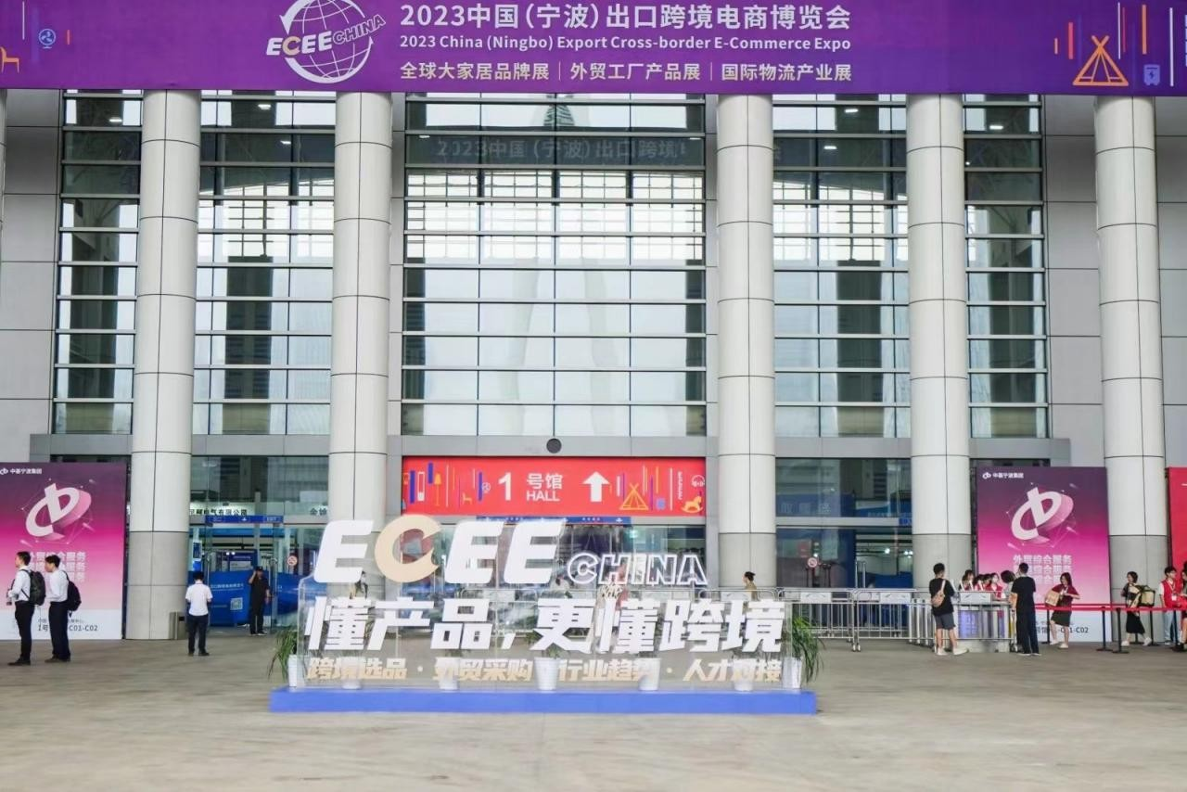


As "the first cross-border Exhibition in East China",
China (Ningbo) Export Cross-border E-commerce Expo and Global Brand Exhibition is one of the most attractive cross- border high- end professional exhibitions in China
指导单位：
浙江省商务厅、浙江省贸促会、宁波市人民政府
支持单位：
宁波市商务局、宁波市贸促会、宁波文旅会展集团
主办单位：
宁波欧德国际商务咨询服务有限公司 宁波市跨境电子商务协会
宁波市家居产业协会

Slide 10




参展品类
Đồ nội thất và dụng cụ làm vườn | Giường và khung giường, ghế sofa, tủ quần áo, bàn và ghế, vật dụng cộng sinh, đồ nội thất, nội thất, văn phòng, sân vườn, ngoài trời, phòng tắm, trang trí vật liệu xây dựng, trang trí, nhà bếp, thông minh ……
Thiết bị điện và ánh sáng | Ánh đèn lên, mát-xa thiết bị, XiaoJiaDian, máy giặt, tủ lạnh, LengGui, đeo tai nghe, DianZiZhong, việc dấu nhà bếp, điện tử hàng ngàn ChongQi, đêm đèn nhỏ, sự phản chiếu bầu trời đầy SAO, cái máy ZhaZhi, JiaShiQi, một đồ dùng thiết bị nhiếp ảnh, DianRe khăn chiếc, để DianRe mắc áo, cái stent sản phẩm kỹ thuật số, tôi, LED và1 bộ chuyển, đèn, công việc đèn lên,.. .
Vật nuôi và đồ chơi玩 | Đồ nội thất vật nuôi, vật nuôi, quần áo vật nuôi, đồ chơi vật nuôi, vật dụng y tế vật nuôi, Vật nuôi thú nuôi sống thông minh, nó là loại thuốc, vật nuôi BaoJianPin, vật nuôi, sản phẩm con mèo, chó sản phẩm, thực phẩm vừa trẻ em, và vẫy con ngựa, ngồi bằng đồ chơi, trò ảo thuật đồ chơi trẻ em, đồ chơi nhựa, trẻ em đỡ bước xe, xe đạp, XueBuChe, viết bảng vẽ, một autobot xe vào thành chiếc ghế an toàn trẻ em, cái ghế an toàn, dean kamen, evan tron sản phẩm, con nít xe … phát triển trí tuệ …

Slide 11


Change Now
Link Future
跨 境 选 品 · 外 贸 采 购 · 行 业 趋 势

